Slide 1
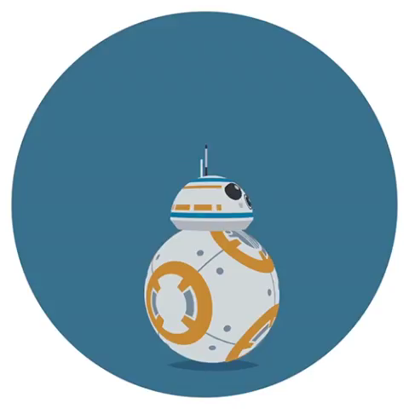
Duke Tutor Mobile App
Team name: BB8
Milestone presentation

Slide 2
Content
Introduction
Problem and Risk Analysis
Plan Updating
Recent Work

Slide 3
Introduction --- User story
Registration
Add profile
Search class
Make confirmation
Feedback
Notes:
What is out app? Why we need it?
In duke, there are super talented people gathering,
Many people have special skills.
Durham is small, not enough resources available
Suppose you want to learn Tai Chi……
So our app helps match peer tutors with peer tutees at ease
The procedure of how our app works is like this:
Registration
Profile: Identity, interested fields and available time, post a listing with a subject/time/location of a tutoring session
Set up the filter to search other tutors' offerings from the nearest ones.
The tutor and tutee will discuss and decide the final time and location to meet, after they make a confirmation, the system will record it.
After a tutoring session, the tutee could leave feedback and this will appear on the tutor’s profile for others’ reference.

Slide 4
Introduction --- Architecture
Tutor view
Course information post
Information collector
Server
Database
Conversation
Query collector
Feedback interface
Tutee view
Notes:
The app will have these basic functions.
Both the tutor and tutee will need the collector for information and conversation module. From the tutor’s view, course information post is a requirement. From the tutee’s view, a query about what classes he want to learn and a feedback interface for him to leave rating and comments about the class he just took is necessary.
Server: communicate, process
Database: store information, tutor events, conversations and ratings.

Slide 5
Sprint Information
Feb. 19 – Mar. 4
Sprint 1
Study basics of Java and Android Studio
Registration and Profile collection
Mar. 5 – Mar. 18
Sprint 2
Searching engine, conversation module
Scalability and load balance
Mar. 19 – Apr. 2
Sprint 3
Confirmation
Payment
Record
Security
Apr. 3 – Apr. 15
Sprint 4
User manual
User Tutor class page
Feedback system

Slide 6
Problem and Risk Analysis
Spring Break
Keyword search precision
Money involved??
People's personal security

Slide 7
Plan Updating
Major change 1: Add user main page
Major change 2: Set some requirements as optional:
1. User login with other popular apps
2. Payment system
Major change 3: Work division
Two work on frontend, two work on backend

Slide 8
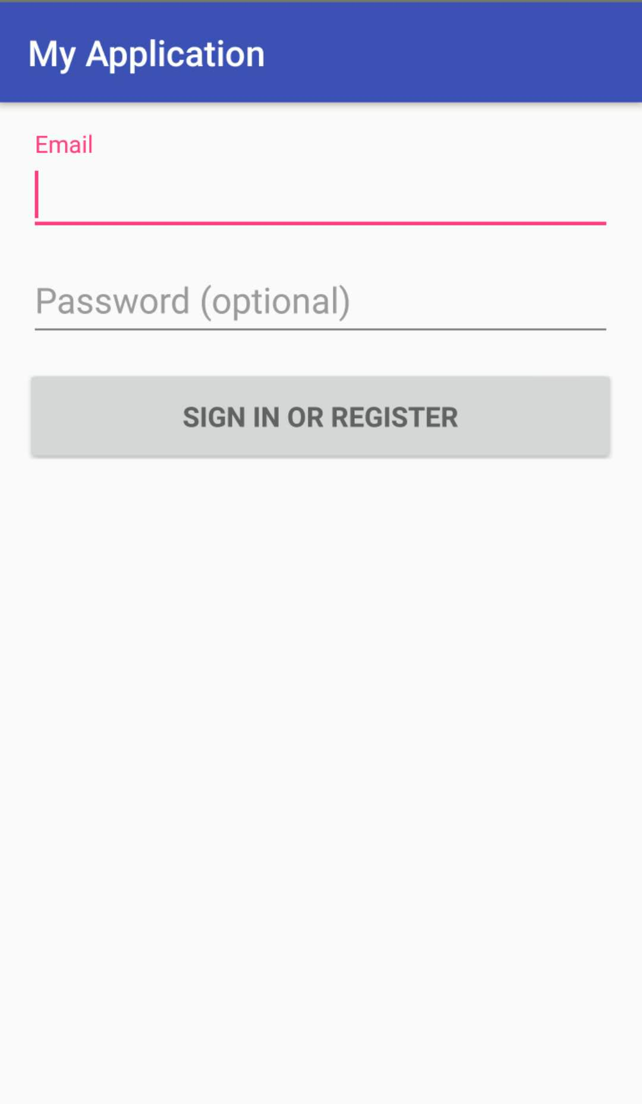
Recent work
Java
Frontend development
Backend development
Notes:
So our recent work mainly includes three parts:
I have to admit that we are falling behind our plan, mainly because I and my
teammates are overloaded with assignments and projects in the recent week.
(I think some of you may have the same feeling.)
So the first thing I can talk about is
1) Learn Java. which has started since homework one, but will continue throughout the project. Currently all of us has JDK installed on our laptops and know
how to compile a Java project.
2) Frontend development. Since we are developing an Android app, we will use
Android Studio as our development envrionment. As of now, two of us have
Android Studio installed, since two of us will be concentrated on frontend
and the other two on backend development.
We can now compile an demo App with Android Studio and run on a simulator or
a phone.
3) Backend development. We will use Java for backend development. But there
are several frameworks out there and we have not decided which one to use.
We think we should talk about this with the TA.

Slide 9
Thank you!

